Slide 1



Carbon Emissions Prediction
Akash Kumar
STU667eaa725a93b1719577202
INTERNSHIP_1746416864681834e0e35d8

Slide 2

Learning Objectives
Understand the impact of socioeconomic and environmental features on Carbon emissions
Learn data cleaning and transformation using Python
Explore and visualize environmental datasets
Build, evaluate, and optimize machine learning regression models
Gain experience in feature engineering and cross-validation
Use predictive analytics to draw real-world environmental insights
TO PREDICT CARBON DIOXIDE EMISSIONS
Source :
www.freepik.com/

Slide 3


Tools and Technology used
Purpose | Tools / Libraries
Programming Language | Python
Development Environment | Jupyter Notebook
Data Processing | Pandas, NumPy
Data Visualization | Matplotlib, Seaborn
Machine Learning | Scikit-learn, XGBoost
File Formats | Excel (.xls), CSV

Slide 4
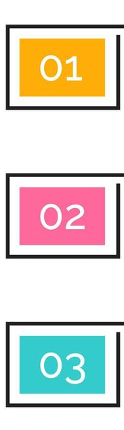
Methodology
Stage | Objective | Key Activities
Stage 1 | Data Cleaning & Preparation | Identified and handled missing and inconsistent data entries Converted categorical and numerical data into appropriate formats Restructured and merged datasets for unified analysis Exported clean, analysis-ready data to CSV format |
Stage 2 | Exploration & Visualization | Visualized feature relationships using heatmaps, histograms, and scatter plots Detected outliers and statistical anomalies in key metrics Engineered additional features to enhance model learning Identified patterns and correlations influencing CO₂ emissions |
Stage 3 | Modeling & Evaluation | Applied Recursive Feature Elimination (RFE) for feature selection Trained multiple regression models including Random Forest and XGBoost Tuned hyperparameters using cross-validation techniques Evaluated model performance using R², MAE, and RMSE on test data |

Slide 5


Problem Statement:
Analyze historical, country-specific data and develop machine learning models to predict CO₂ emissions based on national parameters.
Data Source:
Publicly available Climate Change Data from the World Bank Group (1990–2011), covering:
🌍 Country data: majority of nations worldwide
📅 Year range: 1990 to 2011
🌫 Emissions: CO2, CH4, N2O
👥 Population: total, urban %, growth rate
💰 Economic indicators: GDP, GNI, FDI
🌾 Land: cereal yield, agricultural land, protected areas
☁ Climate: precipitation, natural disasters
⚡ Energy usage
🏥 Health: number of medical staff and infrastructure

Slide 6
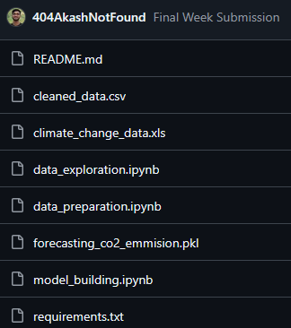
Solution:
We developed a complete machine learning pipeline to predict CO₂ emissions using historical, country-level data from the World Bank.
🔧 Data Pipeline & Modeling:
• Cleaned and merged multi-dimensional datasets (1990–2011)
• Explored feature relationships and emission trends
• Engineered relevant features to improve model accuracy
• Trained and tuned regression models (Linear, Random Forest, XGBoost)
📊 Results:
• Random Forest Regressor achieved the highest R² score
• Key emission predictors: GDP, energy usage, urban population %
• Model enables country-wise emission forecasting for policy analysis
🔗 GitHub Repository: https://github.com/404AkashNotFound/carbon_emission_prediction

Slide 7
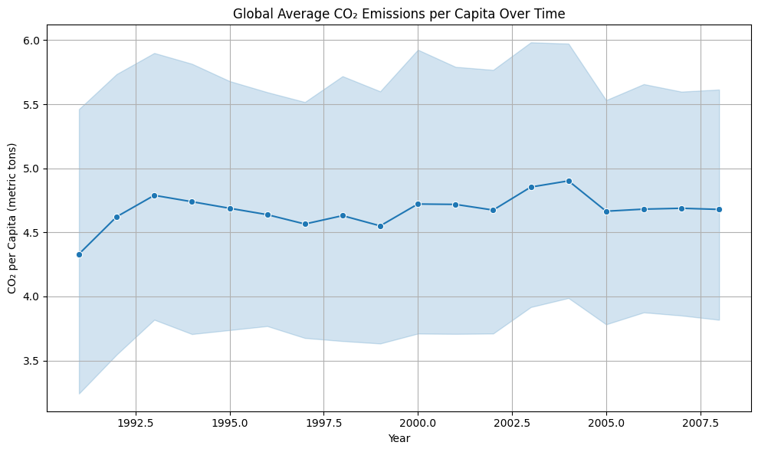
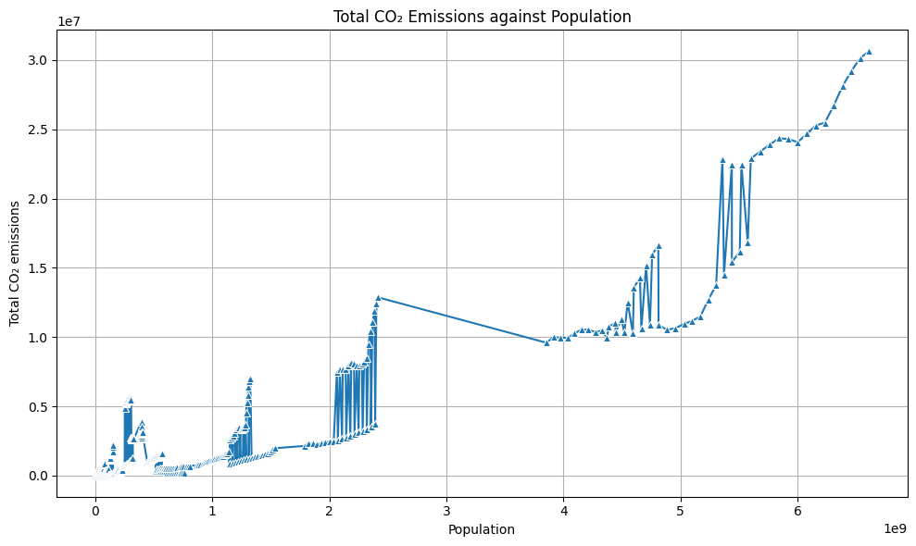
Screenshot of Output:

Slide 8
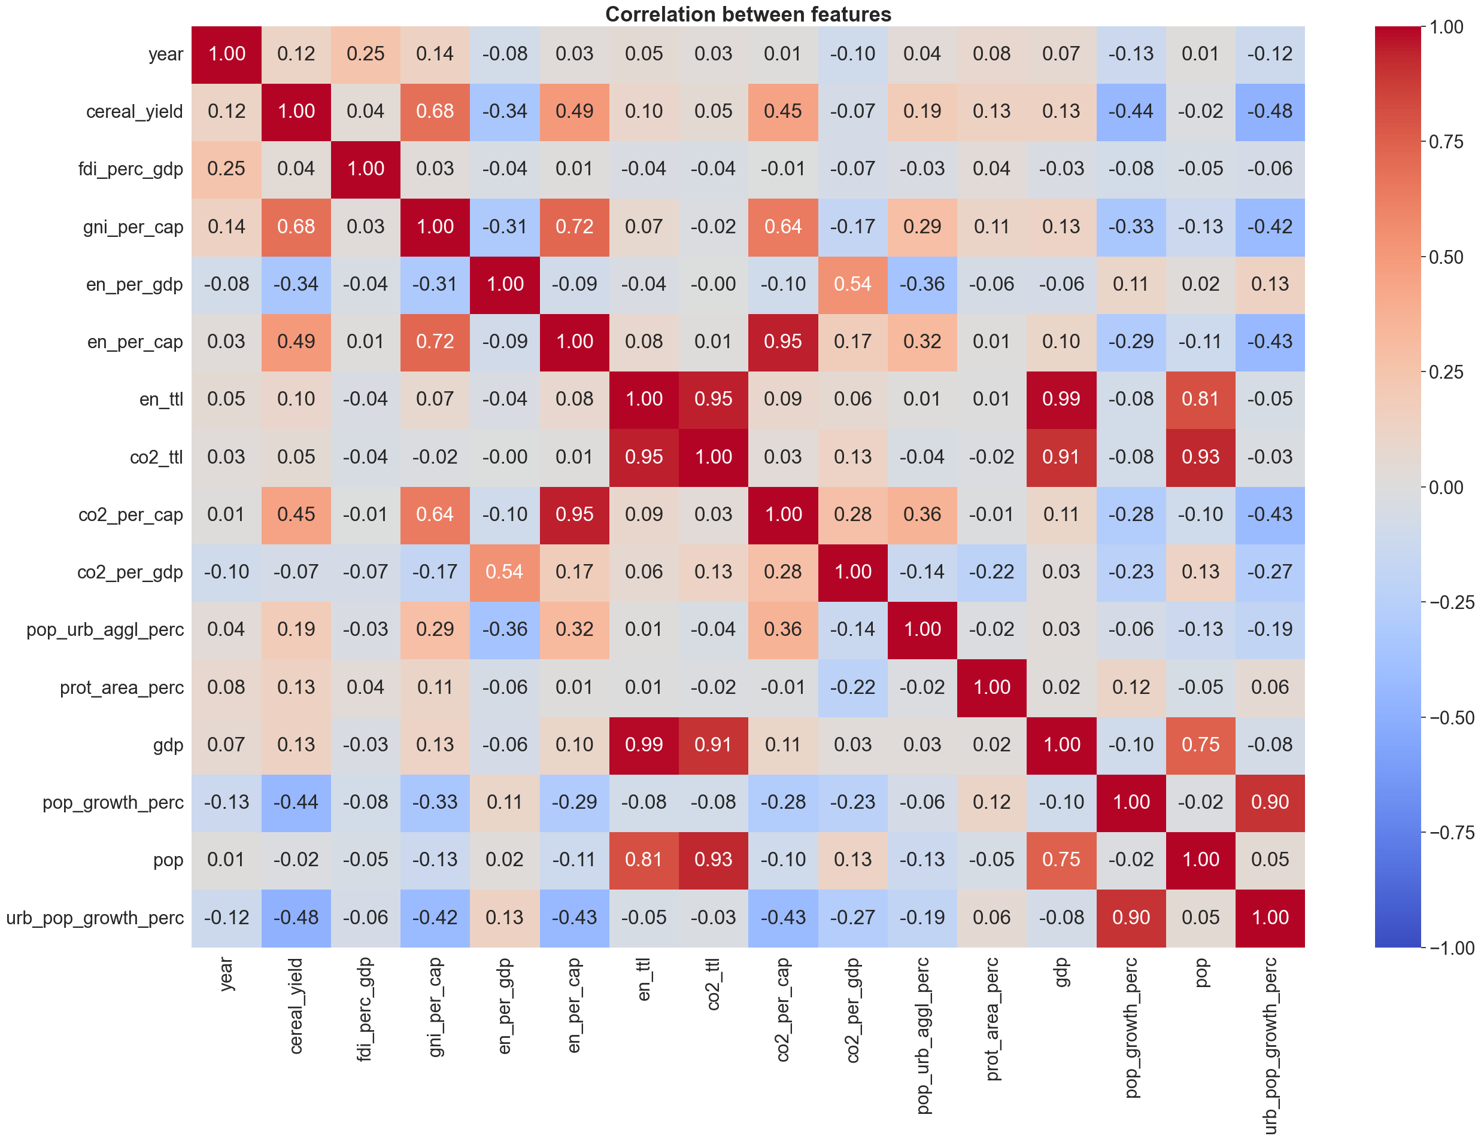
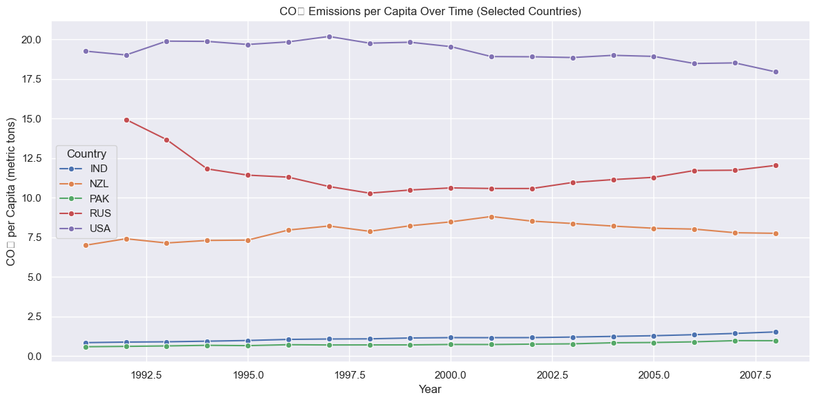
Screenshot of Output:

Slide 9
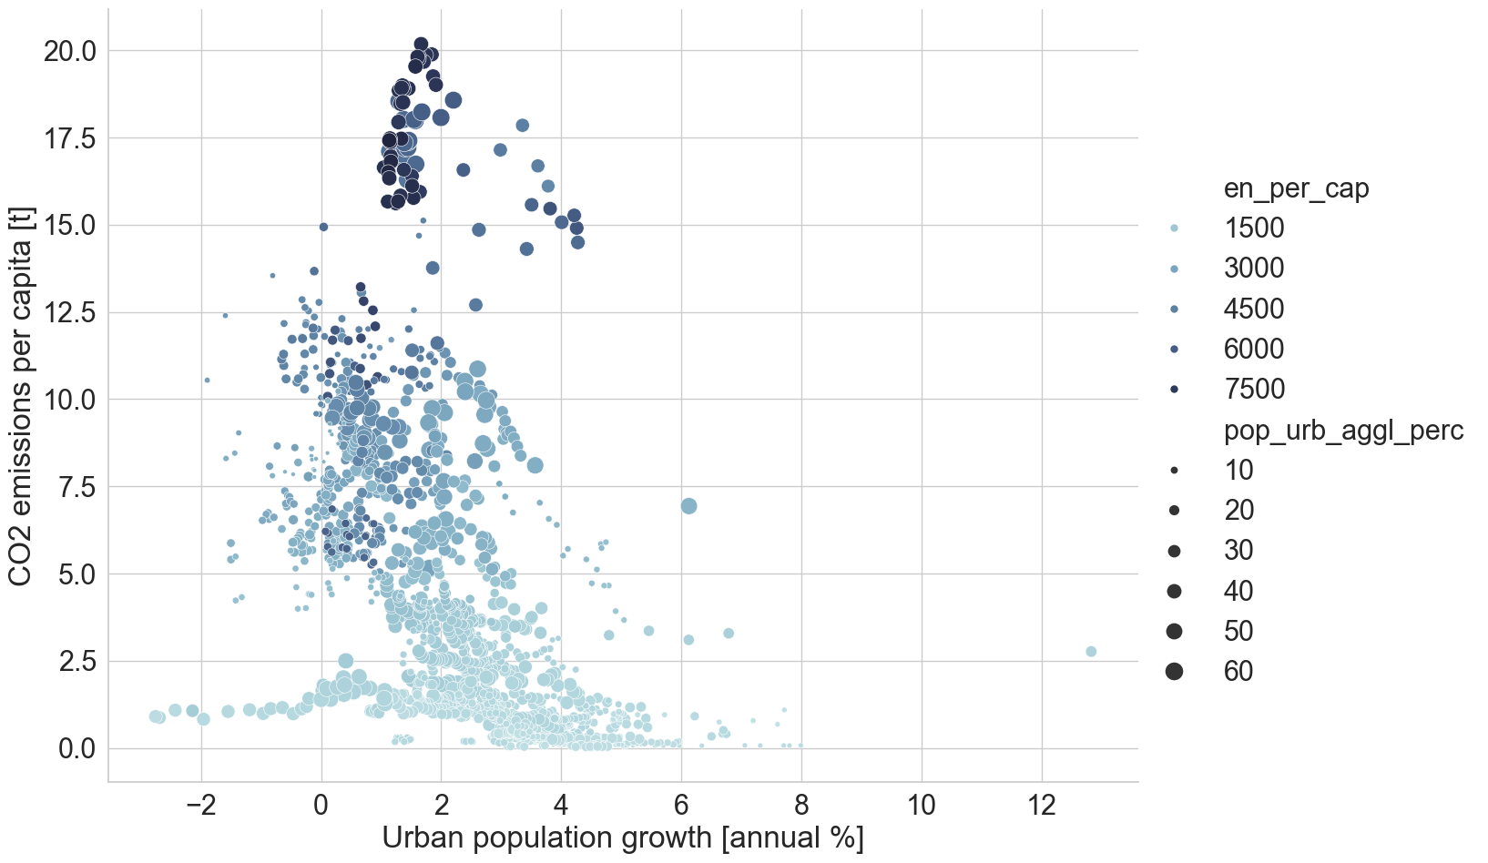
Screenshot of Output:

Slide 10
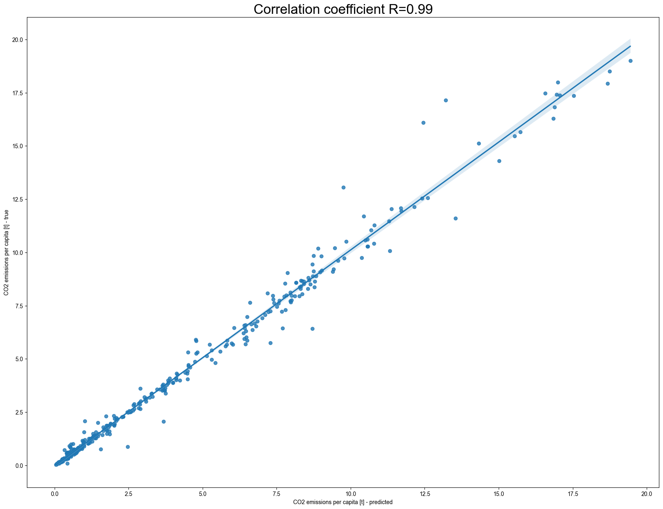
Screenshot of Output:

Slide 11
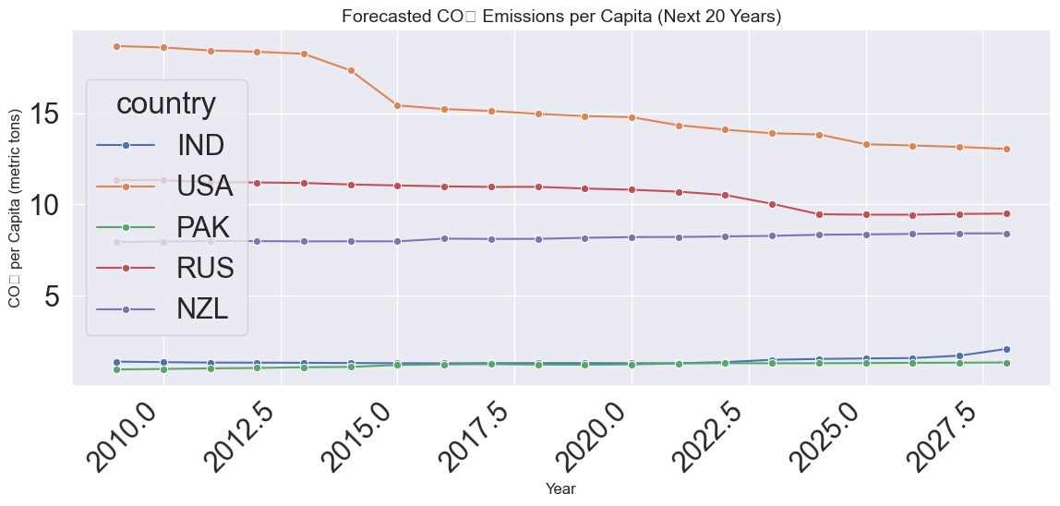
Screenshot of Output:

Slide 12
Conclusion:
🔚 Project Summary:
We successfully developed a machine learning pipeline to analyze and predict CO₂ emissions using historical, country-specific data.
📈 Technical Highlights:
• Cleaned and merged multi-dimensional datasets (1990–2011)
• Conducted in-depth data visualization and feature engineering
• Trained and compared regression models: Linear, XGBoost, Random Forest
• Achieved high accuracy with Random Forest Regressor (best R² score)
🌍 Insights:
• Key predictors of CO₂ emissions: GDP, energy usage, and urbanization
• Forest area shows a negative correlation with emissions
• ML-based forecasting can assist governments in climate decision-making
🚀 Future Scope:
• Integrate real-time global datasets via APIs
• Deploy interactive dashboards with Streamlit
• Extend to time-series forecasting (ARIMA, Prophet)
• Incorporate CI/CD and unit testing for production readiness
💻 Project by Akash Kumar
B.Tech (Electronics & Computer Science) – Final Year – KIIT University

